Slide 1
EE447 Senior Lab Design
Rachel Gaines
Javier Maccossay
Kelly Moran
Gabriel Rigney
Notes:
Who wants to introduce, Javier, you like to talk?

Slide 2
Overview
Invention
Similar Patented Technology
Distinguishing Features
Application
Business Plan
Future Prospects
Appendix
2
Notes:
Javier

Slide 3
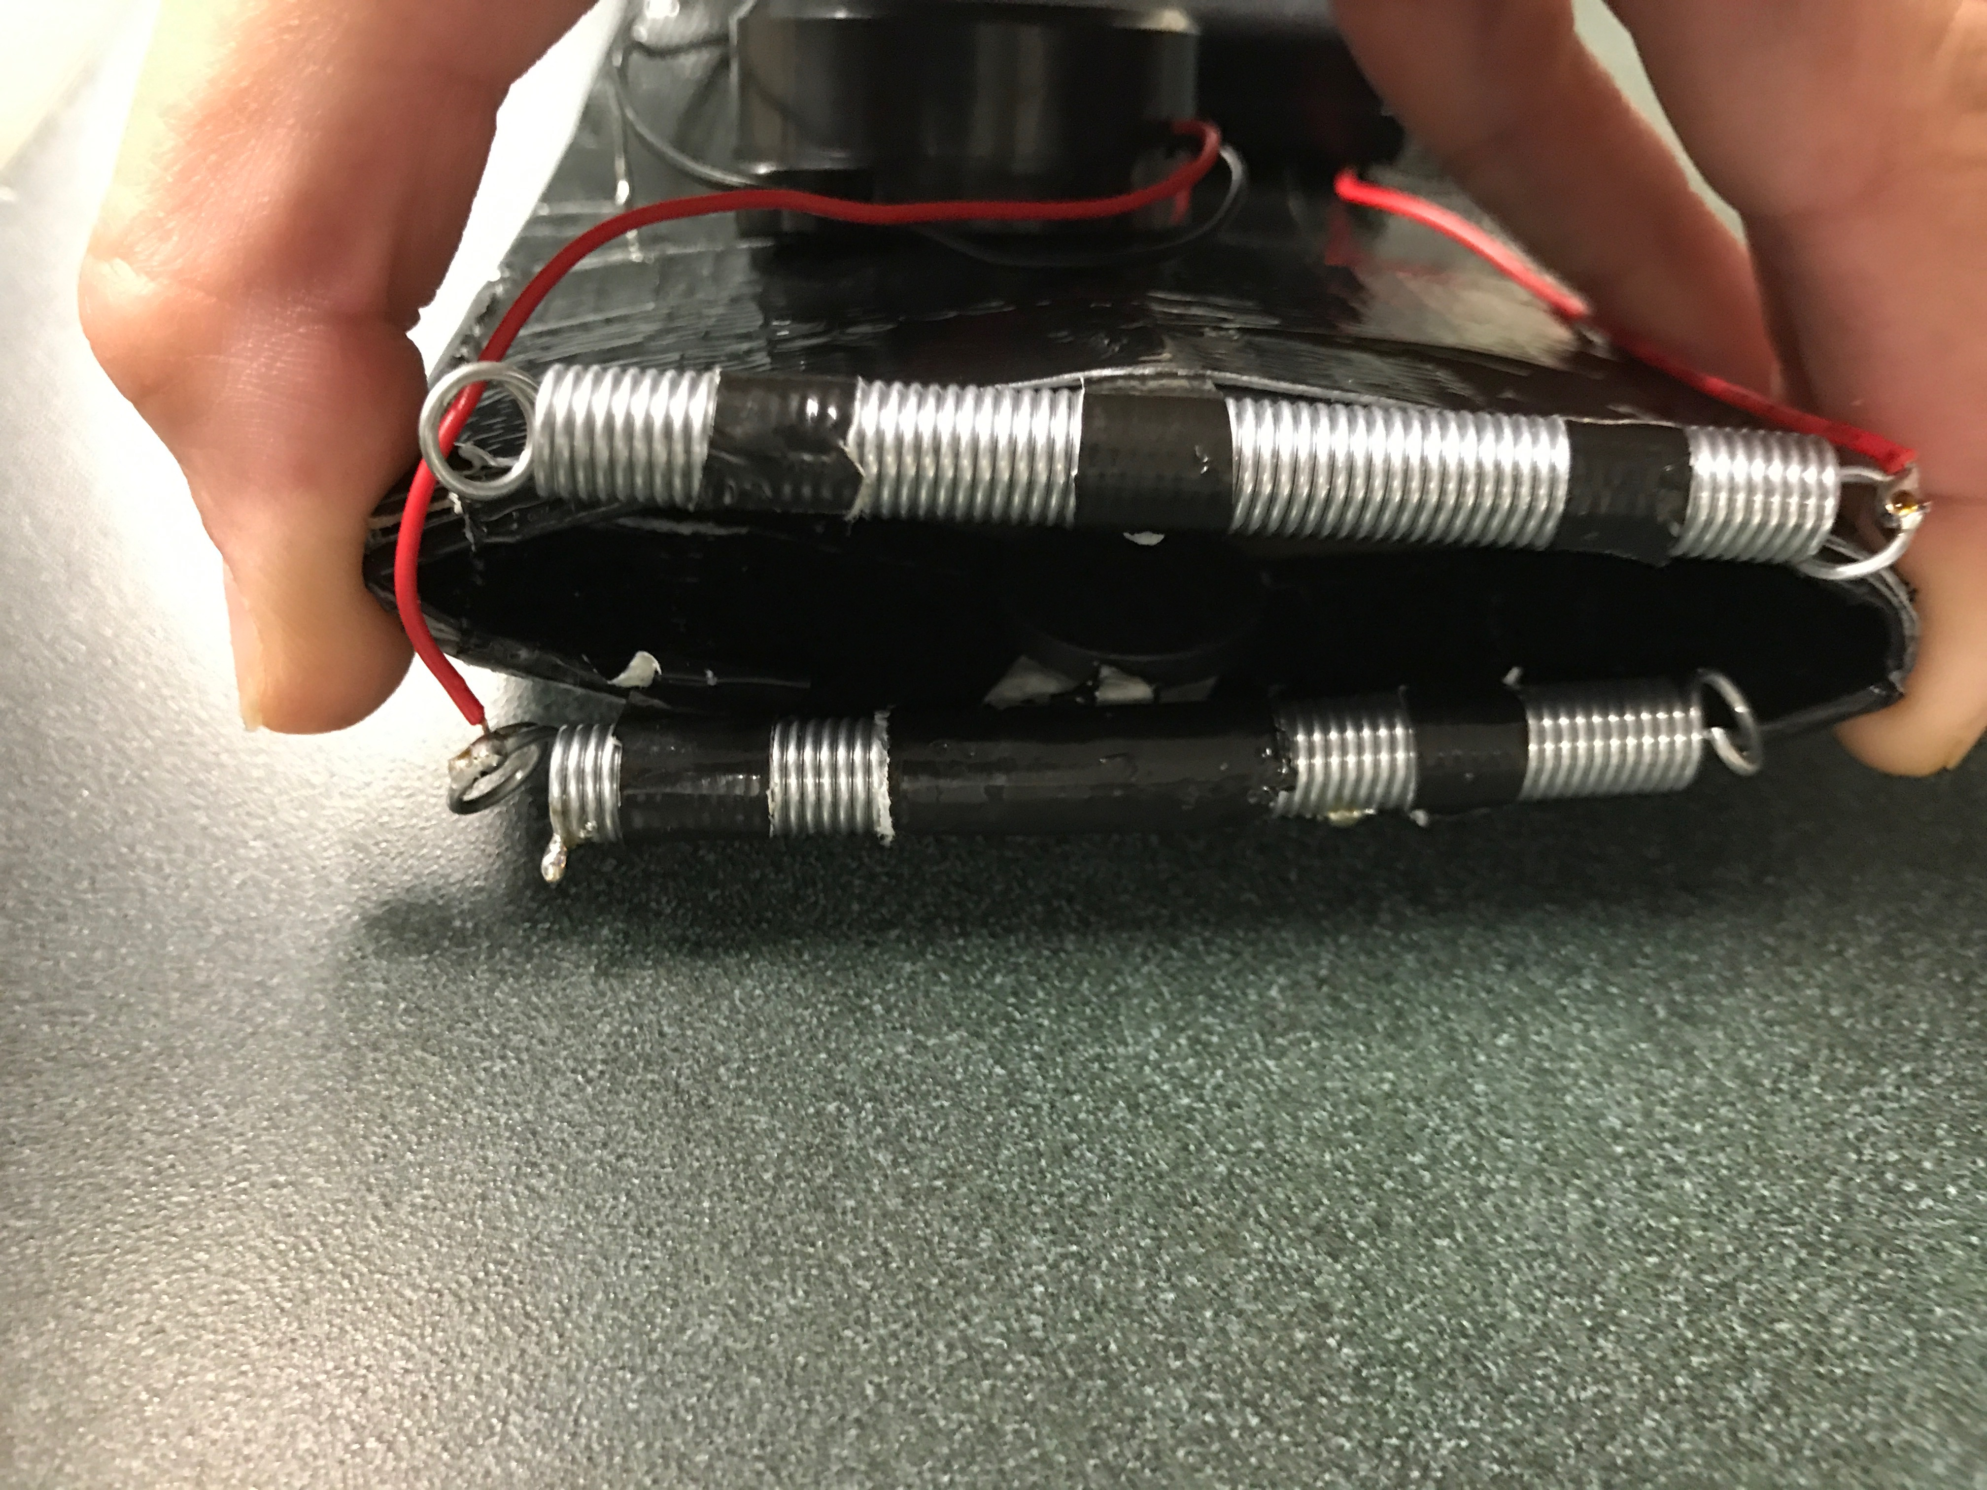
Anti-Theft Holster
The Anti-Theft Holster is a simple, affordable solution to pickpocketing that alerts a user when their wallet has been removed from their person
Holster that can be clipped onto a belt loop or slipped into a pocket
Wallet, cell phone, or comparably sized item can be secured in the holster
When armed, siren activates if holster's contents are removed
Name of Invention
Invention
Similar Patented Technology
Distinguishing Features
Application
Business Plan
Future Prospects
Appendix
3
Notes:
Gabe talks since it was your basically idea (SUPER ENTHUSIASTIC GABE, YAY, THE PLUMBER IS COMING TO INVEST IN US YAY!!)

Slide 4
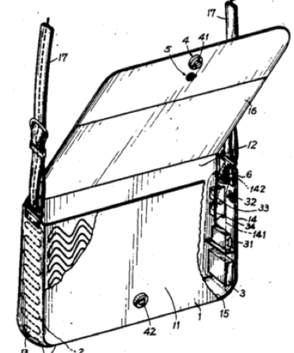
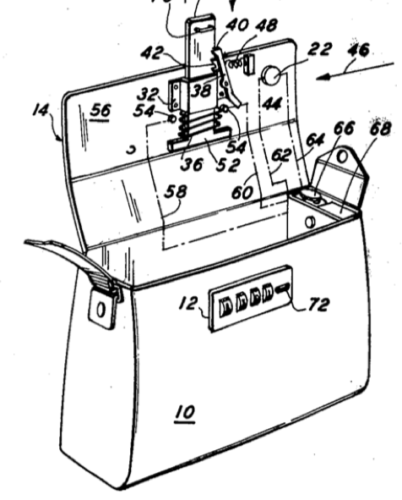
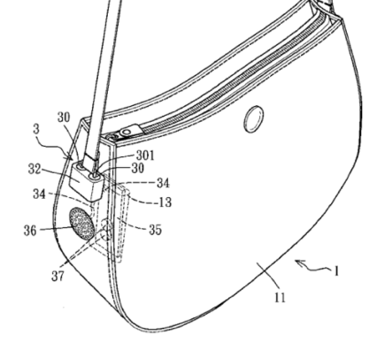
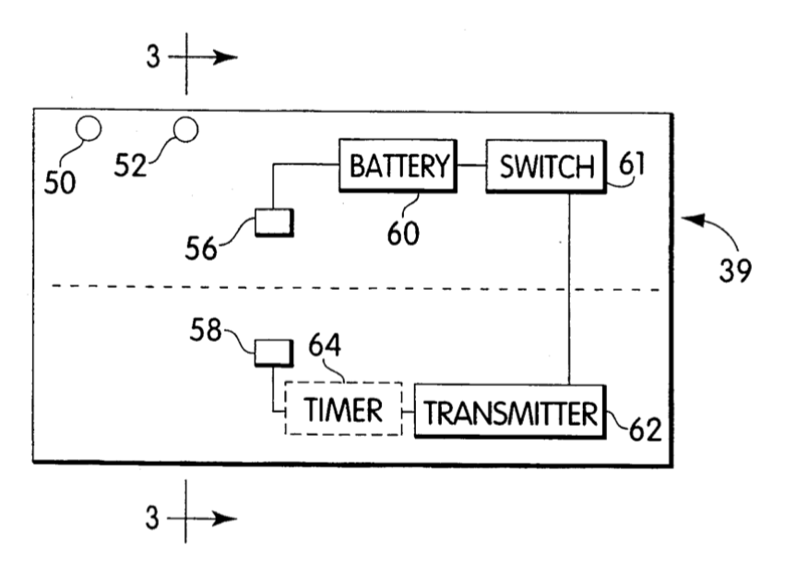
Similar Patented Technology
Our anti-theft wallet would fall into the class purses, wallets and protective covers (150) and subclass theft or loss resistant (102)
Robbery-Preventing and Body-Protecting Handbag
Alarm for Car Shaped Object
Steal and Burglar Preventive Purse
Bag Alarm Device
3
4
1
2
Buzzer activates immediately when magnet members are separated
Alarm sounds when wire is broken
Audio and visual alarms when bar is in closed position
Adjustable alarm to sound when card is absent
Name of Invention
Invention
Similar Patented Technology
Distinguishing Features
Application
Business Plan
Future Prospects
Appendix
4
Notes:
Kelly talks

Slide 5
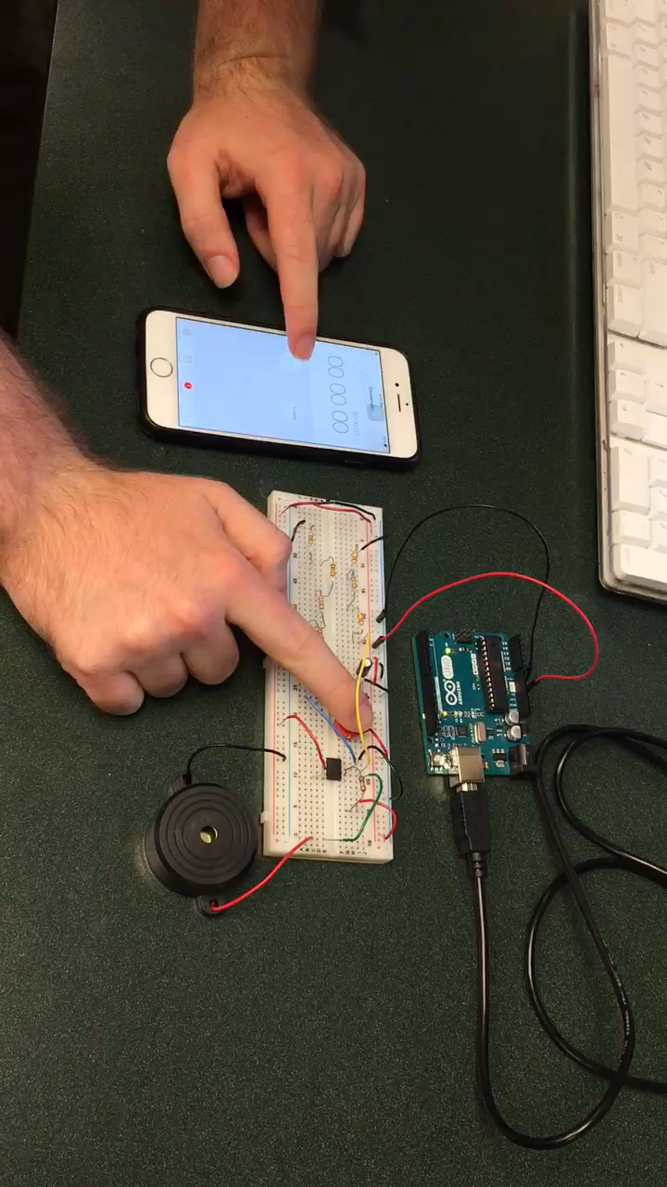
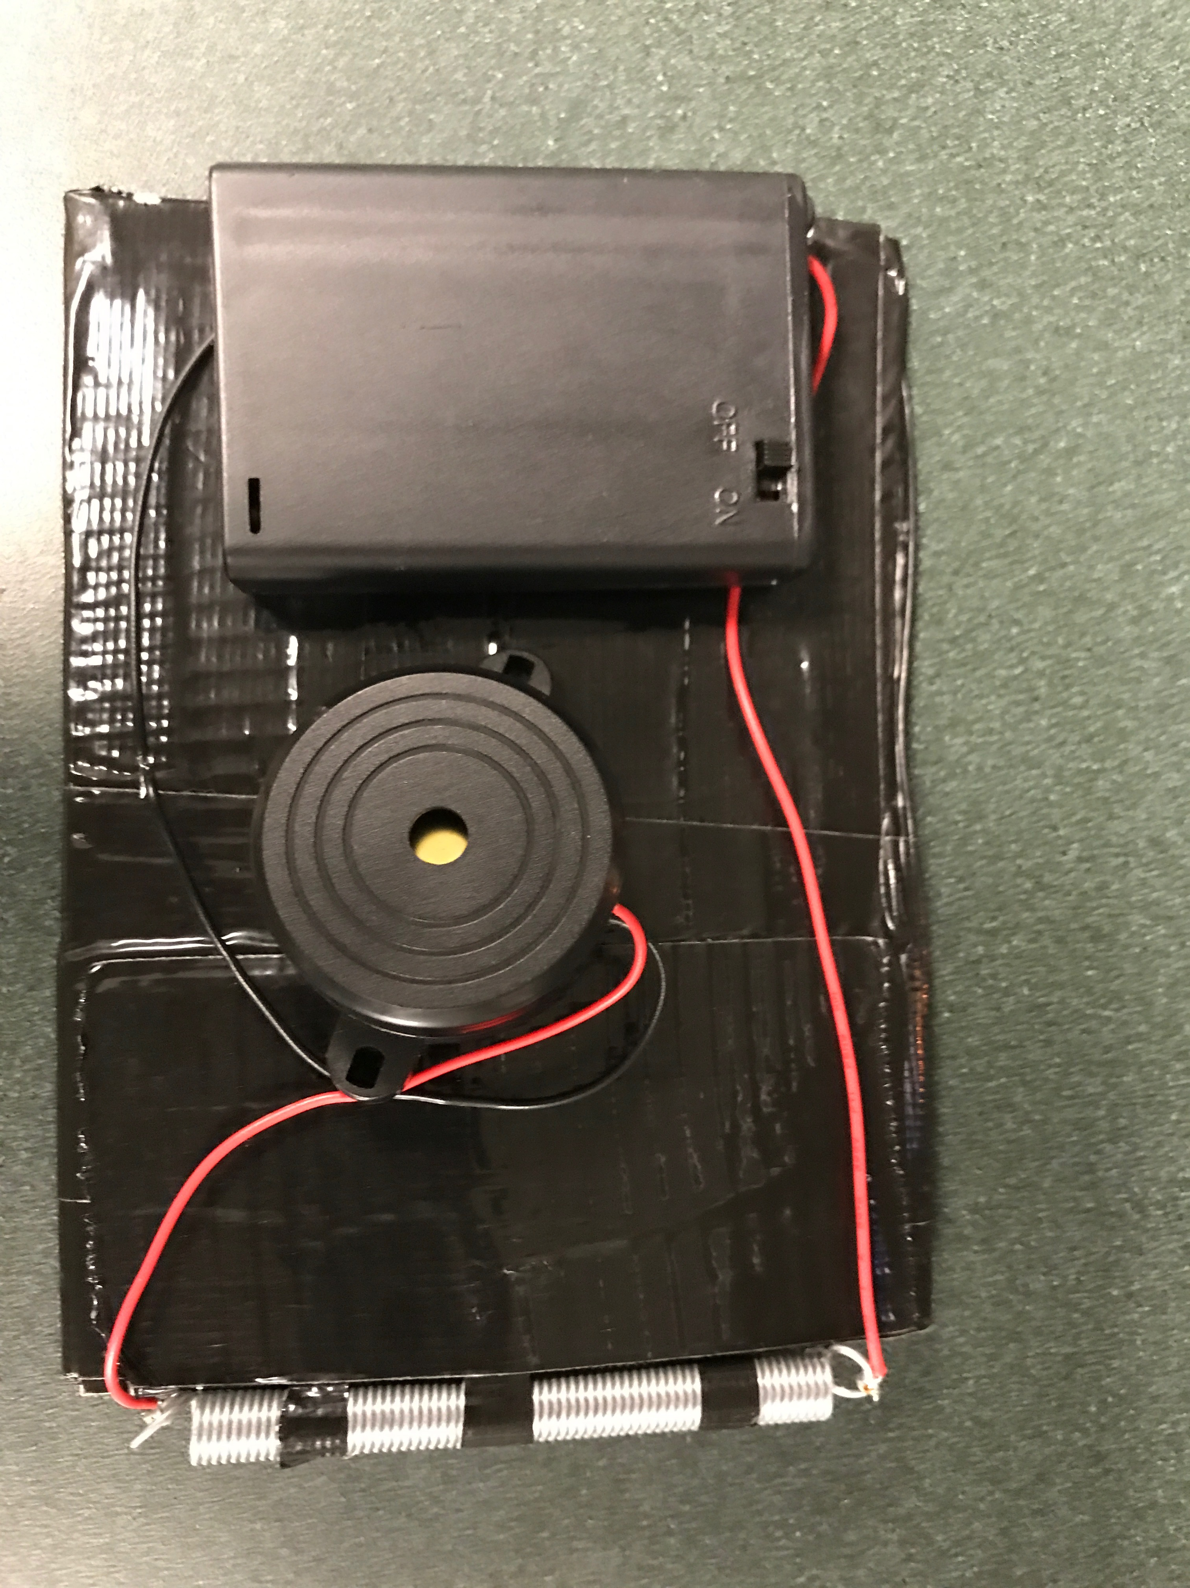
Distinguishing Features
Our invention is unique in that the wallet and holster form a pair that prevents theft and forgetfulness
Activation switch to arm device
Alarm sounds until placed back in holster
Alarm sounds 1 min after wallet has been missing
Name of Invention
Invention
Similar Patented Technology
Distinguishing Features
Application
Business Plan
Future Prospects
Appendix
5
Notes:
Rach slide/talks

Slide 6
Application
The Anti-Theft Holster is aimed at alleviating the problem of pickpocketing for members of society
Pickpocketing is on the rise in major cities, especially in Europe
Ethical and Societally Helpful
Evolved from Tazer Wallet Idea
Name of Invention
Invention
Similar Patented Technology
Distinguishing Features
Application
Business Plan
Future Prospects
Appendix
6
Notes:
Rach talk

Slide 7
Business Plan
The Anti-Theft Holster has the potential to provide moderate returns in the United States, with an even larger potential for profitability overseas
Production Costs
Market
Prototype Cost Breakdown
Battery Pack: $3.25
Piezzo Buzzer: $4.00
Apparatus Materials: <$0.75
Total Cost: $8.00
Manufacturing Haircut: 20%
Total Cost: $6.4
Retail Price: $15
Target Customer: Middle aged/living in metropolis
Number of Target Customers: 141.15 million
Penetration Rate: 1%
Market Size: 1.41 million
Revenue
21.2 MN
Profit
12.1 MN
Name of Invention
Invention
Similar Patented Technology
Distinguishing Features
Application
Business Plan
Future Prospects
Appendix
7
Notes:
Kelly slide/talks

Slide 8
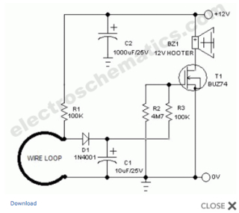
Future Prospects
Future versions of the holster could come in deluxe and standard models and feature more advanced circuitry
Siren attached to the wallet as well as holster
More complex circuitry for enhanced user experience
Decreased size, versions for purses and other wallet styles
Smaller batteries, smaller buzzer
Name of Invention
Invention
Similar Patented Technology
Distinguishing Features
Application
Business Plan
Future Prospects
Appendix
8
Notes:
Javier’s slide/talk

Slide 9
Appendix
Small wallet alarm using LM555 converting from DC to AC
Timing circuit using TLC 3702 and LED
Derivation of Market Size
Name of Invention
Invention
Similar Patented Technology
Distinguishing Features
Application
Business Plan
Future Prospects
Appendix
9

Slide 10
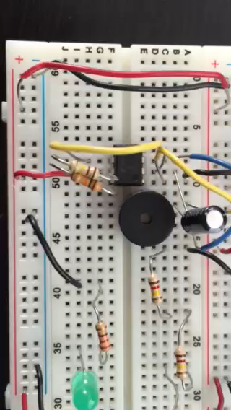
Appendix
Small wallet alarm using LM555 converting from DC to AC
Name of Invention
Invention
Similar Patented Technology
Distinguishing Features
Application
Business Plan
Future Prospects
Appendix
10

Slide 11
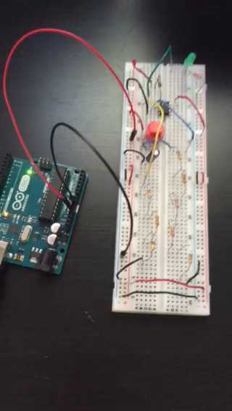
Appendix
Timing circuit using TLC 3702 and LED
Name of Invention
Invention
Similar Patented Technology
Distinguishing Features
Application
Business Plan
Future Prospects
Appendix
11

Slide 12
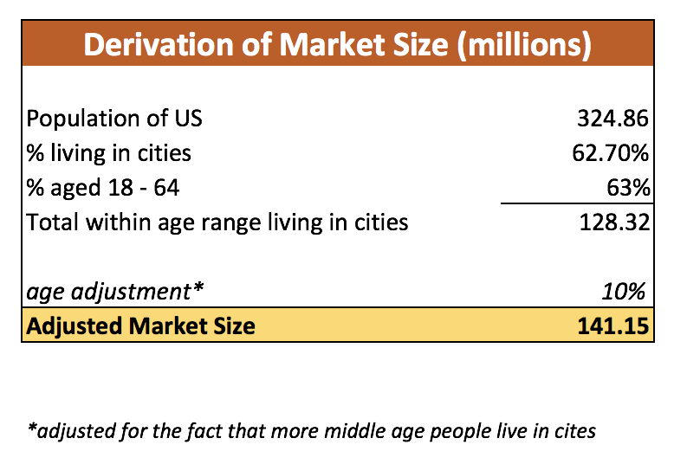
Appendix
Derivation of Market Size
Name of Invention
Invention
Similar Patented Technology
Distinguishing Features
Application
Business Plan
Future Prospects
Appendix
12

